Slide 1
Digital Portfolio
STUDENT NAME: MUTHUKUMARAN D
REGISTER NO AND NMID: asanm222anm22224ucsc030
DEPARTMENT: Bsc Computer science
COLLEGE: COLLEGE/ UNIVERSITY :- Es arts & science college villupuram/ ANNAMALAI UNIVERSITY

Slide 2
PROJECT TITLE
QuizUp: A Fun Learning Experience – An Interactive Web-Based Quiz Application for Enhancing Knowledge and Engagement

Slide 3


AGENDA
Problem Statement
Project Overview
End Users
Tools and Technologies
Portfolio design and Layout
Features and Functionality
Results and Screenshots
Conclusion
Github Link
3/21/2024 Annual Review

Slide 4

PROBLEM STATEMENT
The traditional learning methods can be monotonous and unengaging for students.
There's a need for an interactive platform that makes learning fun and assesses knowledge in an engaging way.
Notes:
The traditional learning methods can be monotonous and unengaging for students. There’s a need for an interactive platform that makes learning fun and assesses knowledge in an engaging way.

Slide 5

PROJECT OVERVIEW
"QuizUp: A Fun Learning Experience" is a web-based quiz application designed to make learning interactive and fun.
The app presents users with a series of questions across various topics, tracks their scores, and provides feedback on their performance.

Slide 6

WHO ARE THE END USERS?
The primary end users of this application are:-
Students looking for an engaging way to test their knowledge.-
Educators seeking interactive tools to enhance learning experiences

Slide 7

TOOLS AND TECHNIQUES
Tools:*- Visual Studio Code (or any code editor)- GitHub for version control*
Techniques :*-
*Frontend:* HTML, CSS, JavaScript-
*Backend:* None (static site, but could integrate backend technologies like Node.js if needed)-
*Database:* None (quiz data is stored in a JavaScript array, but could integrate a database like MongoDB for larger datasets)

Slide 8
POTFOLIO DESIGN AND LAYOUT
*User-friendly interface:*
Easy navigation and clear display of questions and options.-
*Score tracking:*
Displays the user's score at the end of the quiz.-
*Feedback mechanism:*
Provides correct answers and explanations for each question.-
*Retry option:*
Allows users to retake the quiz.
8

Slide 9
FEATURES AND FUNCTIONALITY
*Interactive Quiz Interface*: Engaging and user-friendly design for a seamless quiz experience.
2. *Randomized Questions*: Questions are shuffled to provide a unique experience each time.
3. *Score Tracking*: Displays user’s score in real-time.
4. *Instant Feedback*: Provides correct answers and explanations for each question.
5. *Retry Option*: Allows users to retake the quiz.
6. *Show Answers*: Displays correct answers and explanations for all questions.

Slide 10
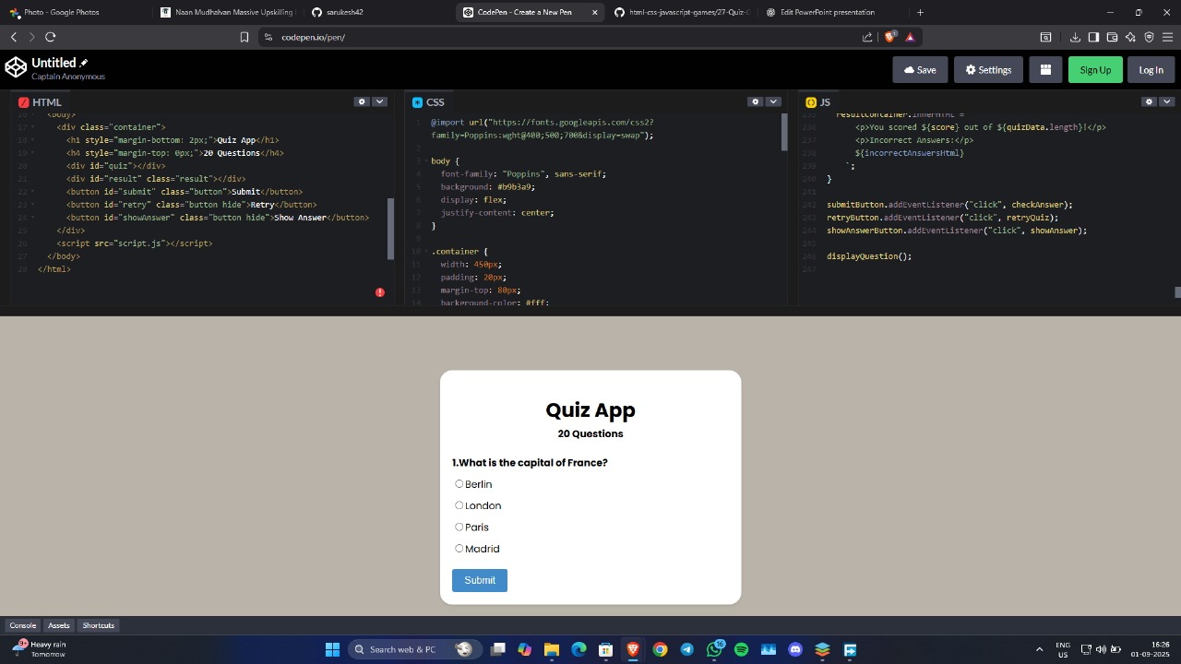

RESULTS AND SCREENSHOTS
RESULTS & SCREENSHOTS : -
3/21/2024 Annual Review
10

Slide 11
CONCLUSION
“QuizUp: A Fun Learning Experience” is an innovative web-based quiz application that makes learning engaging, interactive, and fun.
By providing a user-friendly interface, instant feedback, and a retry option, it encourages users to test their knowledge and learn from their mistakes.
This project showcases the potential of interactive learning tools in enhancing education and promoting academic excellen
11

